Slide 1

Babble-go Topic-Based Empathic Chatbot
Team Members:
Rahul Yadav (rahulyad)
Ankit Shaw (ashaw7)
Kajol (kajol)

Slide 2
Topics for Discussion
Problem Statement
Literature Review
Proposed System
Evaluation Metric
Project Plan & Timeline

Slide 3
Problem Statement

Slide 4
Summarizing Project Objectives
Develop conversational system for open-domain chit-chat and topical conversations
Receive user queries, generate appropriate responses based on context, which can include opinions, facts and general conversations
Implement dialogue manager selects which response generator to be prioritized.
System should understand user emotions and respond with empathy.

Slide 5
Literature Review

Slide 6
Existing Systems and Research
Proto uses a transformer-based model for language modeling, a BERT-based model for response selection, and a knowledge grounding model that leverages external knowledge sources.
TransferTransfo is generative data-driven dialogue system utilizes transfer learning and a high-capacity Transformer model for fine-tuning, with a multi-task objective that combines unsupervised prediction tasks.
ChatGPT incorporates a reinforcement learning component that allows the model to learn from feedback provided by the human during a conversation and adapt its responses accordingly. This enables the model to improve its performance over time and provide more relevant and accurate responses to the user.

Slide 7
Existing Systems and Research
Alquist introduced multi-level dialogue management with a hierarchical structure to handle complex conversations with multiple sub-topics and subtasks. The bot uses a flexible response generation pipeline with a combination of template-based responses and generative language models to provide natural and diverse responses to user queries.
Chirpy Cardinal introduced a new approach to dialogue management, called "Digression-Driven Dialogue Management," which allows the social Bot to handle conversational digressions and bring the conversation back to the main topic smoothly.
Emotion-Aware Transformer Encoder for Empathetic Dialogue Generation, the emotional state of the conversational partner is encoded as a vector and added to the input sequence. This allows the model to generate more empathetic responses that take into account the emotional state of the conversational partner.

Slide 8
Dataset

Slide 9
Standard Datasets for Empathic Bots
Empathetic Dialogues (ED) dataset introduces a new benchmark and dataset for evaluating open-domain conversational AI models on their ability to generate empathetic responses.
BYU-PCCL chit-chat dataset contains a vast amount(1.4 million messages) of conversational exchanges between real humans.
SimpleWiki is an online encyclopedia that provides a more accessible version of the content found on the regular English Wikipedia.
Using Reddit push shift API to scrap topic-level dataset which comprises post-comment pairs from Politics, Environment, Technology, Healthcare, and Education.

Slide 10
Standard Datasets for Empathic Bots
SimpleWiki is an online encyclopedia that provides a more accessible version of the content found on the regular English Wikipedia.
The Persona-Chat dataset is a collection of over 160,000 persona-based dialogues developed by Facebook AI Research. It is commonly used to train and evaluate chatbot models that aim to provide a more personalized and engaging user experience.

Slide 11
System Architecture

Slide 12
User Query
Intent Identification
Chit Chat Model
Output
Sentiment Detection
Conversational Interface
Dialog Manager
IR Model
Re-Ranking
Language Generation
Explicit or Implicit Feedback Extraction
Knowledge Base (Elasticsearch)

Slide 13
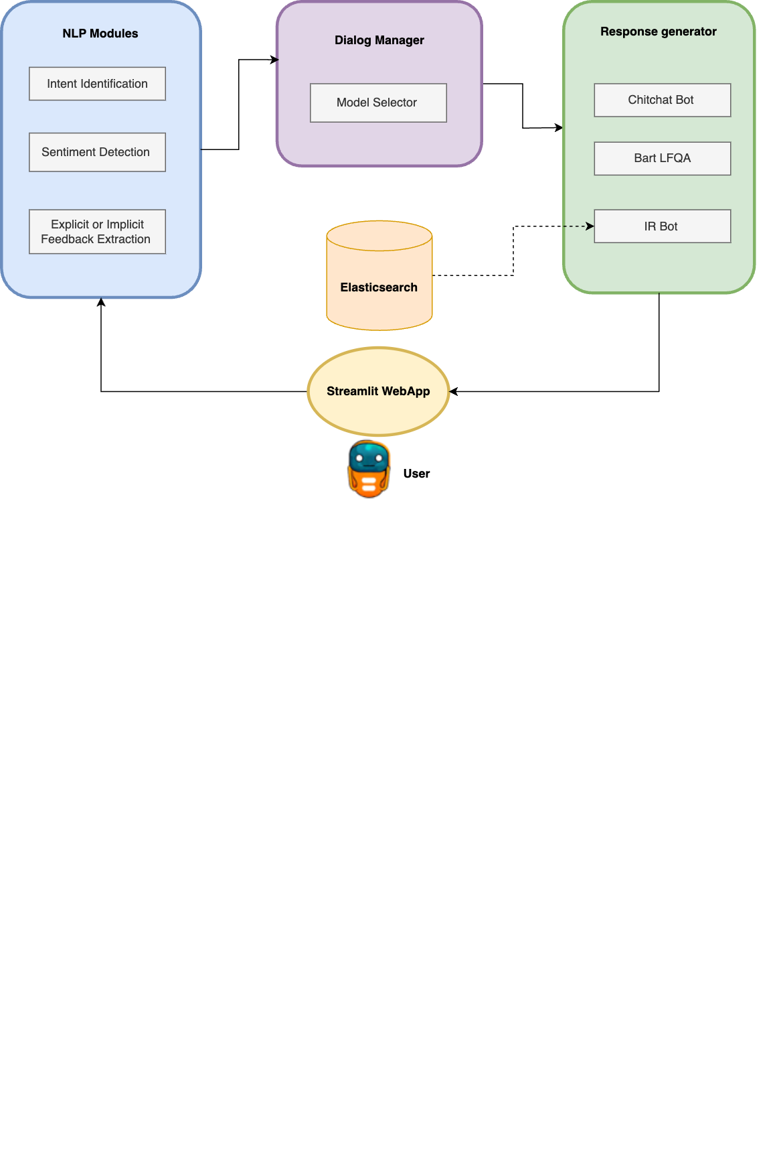




BabbleGo System Architecture

Slide 14
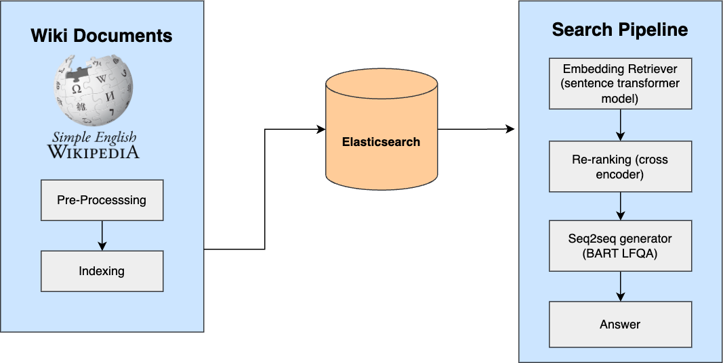
Wiki Bot Design Architecture

Slide 15
Evaluation Metric

Slide 16
Summarizing, Evaluation Metrics
Perplexity - measure how well a language model can predict a given sequence of words
BLEU score - evaluate the quality of machine translation output.
ROUGE score - measure the similarity between an automatic summary or machine-generated text and one or more reference summaries or human-generated texts.
BERT Score - measure the similarity between two pieces of text, such as a machine-generated output and a reference text. Unlike BLEU or ROUGE, which are based on n-gram overlap, BERT Score is based on the representation of text as continuous vectors using a pre-trained BERT model.
BLEURT Score - measure the quality of machine-generated text, such as translations or summaries. Similar to BERT Score, BLEURT Score is based on the representation of text as continuous vectors using a pre-trained transformer model, but it differs in its approach to training and evaluation.

Slide 17
Evaluation Results
INTENT CLASSIFICATION
CONFUSION MATRIX
Accuracy | 0.99
F1-Score | 0.99
43357 | 6
37 | 11836
MILESTONE3
Dataset | Perplexity | BLEU | ROUGE | BERT | BLEURT
Chitchat | 15.64 | 0.0142 | 0.122 | 0.84 | -1.38
Empathetic | 19.31 | 0.0263 | 0.184 | 0.86 | -1.025
Squad2 | 17.97 | - | - | - | -

Slide 18
Test runs

Slide 19


Empathy

Slide 20
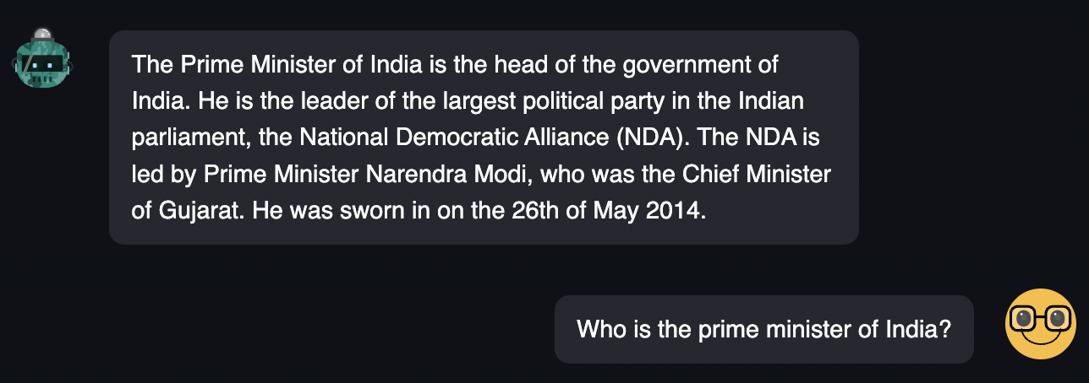

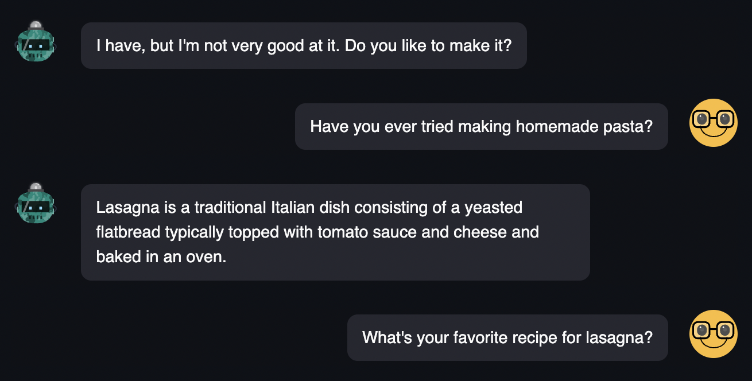
Information Retrieval Query

Slide 21
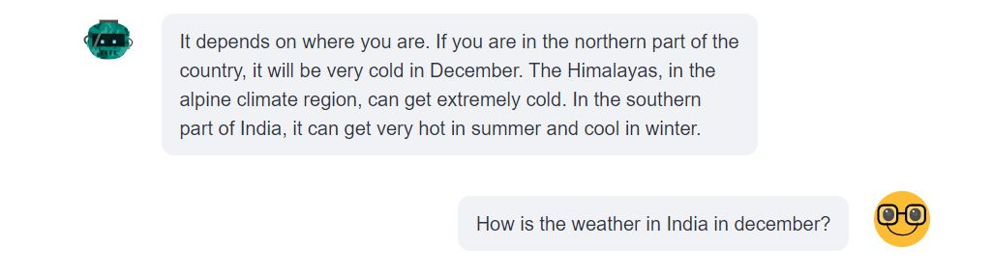
Generative Information Retrieval

Slide 22

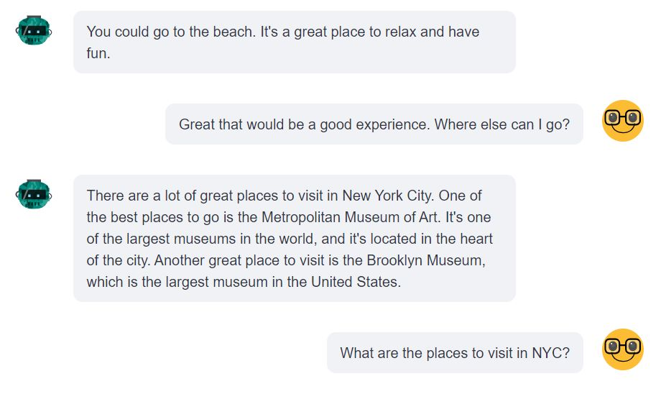
Context

Slide 23
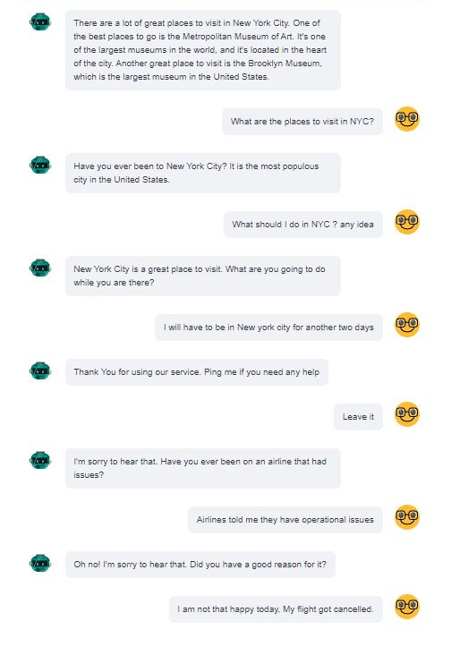

Query with Chitchat and Information Retrieval Combination

Slide 24
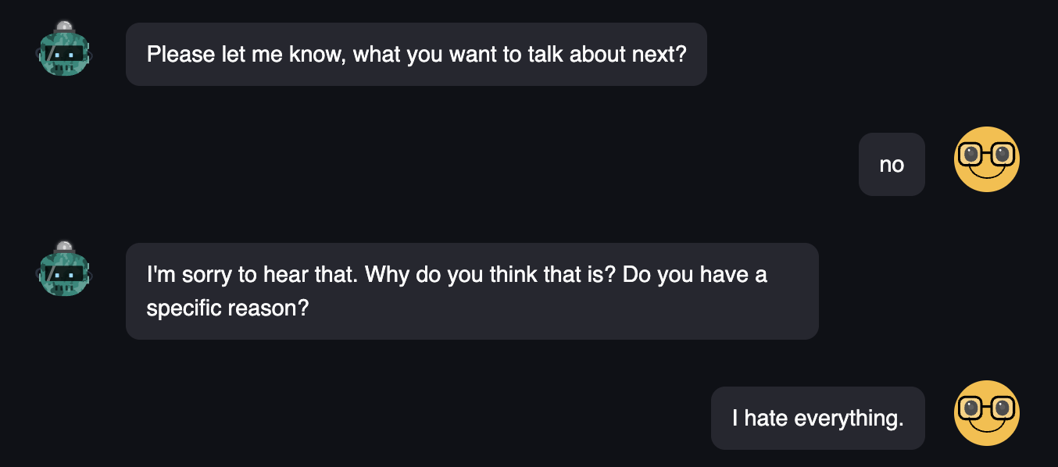
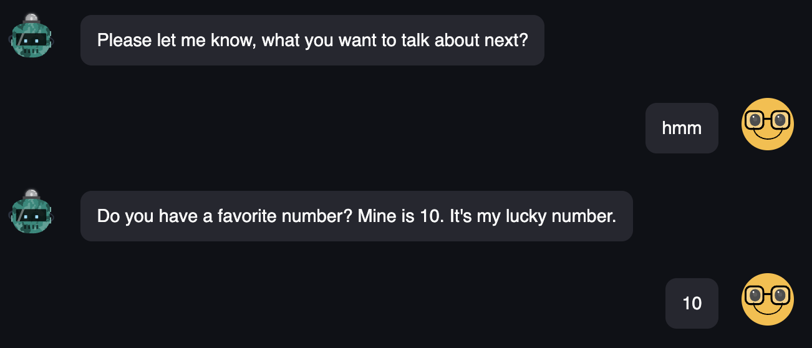

User Feedback

Slide 25


Failed Responses

Slide 26
Project Plan & Timeline

Slide 27
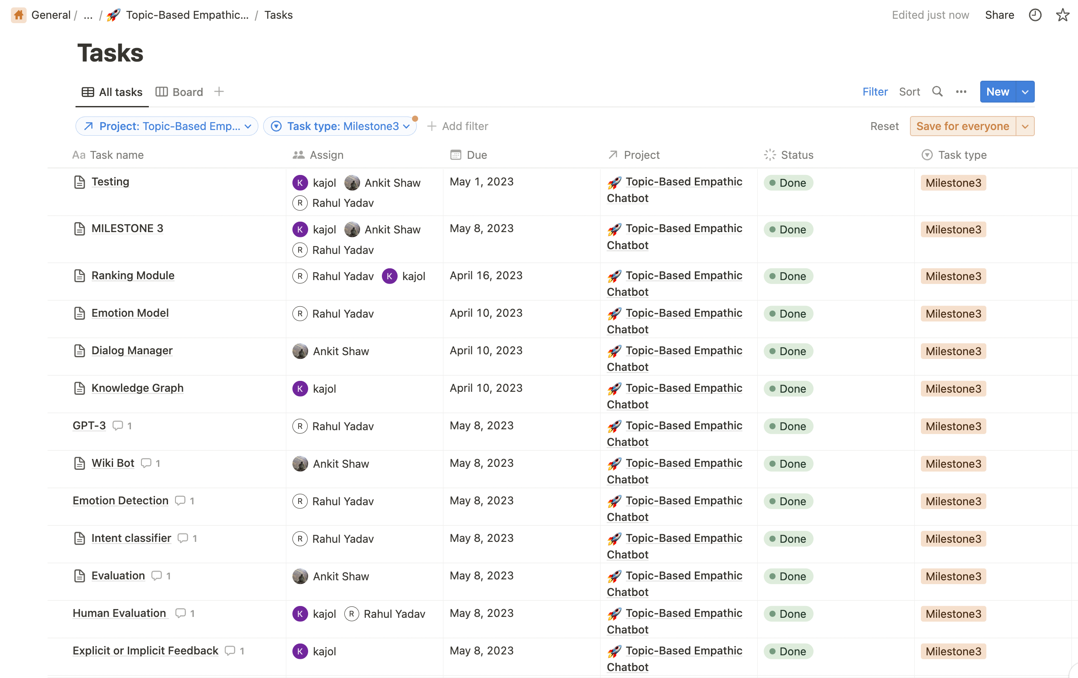

Slide 28
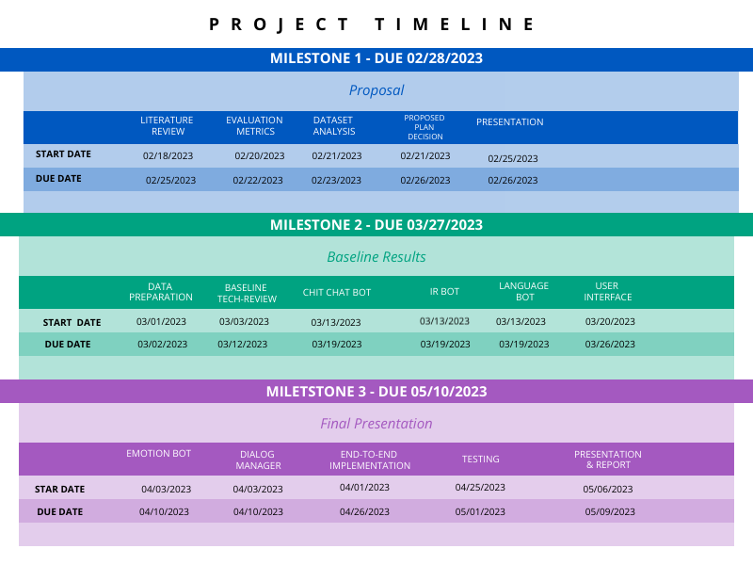

Slide 29
THANK YOU
Any Questions?

Slide 30
User Query
Entity Extraction
Chit Chat Model
Intent Identification
IR Model
Sentiment Detection
Conversational Interface
Theme Identification
Emotion Model
Dialog Manager
Language Model
User Preferences
Knowledge Graph
Topic Recommendation
Ranking Module
Explicit or Implicit Feedback Extraction
DB
Output

Slide 31
User Query
Entity Extraction
Chit Chat Model
Conversational Interface
Intent Identification
Ranking Module
Output
Entity Linking
IR Model
Knowledge Base

Slide 32
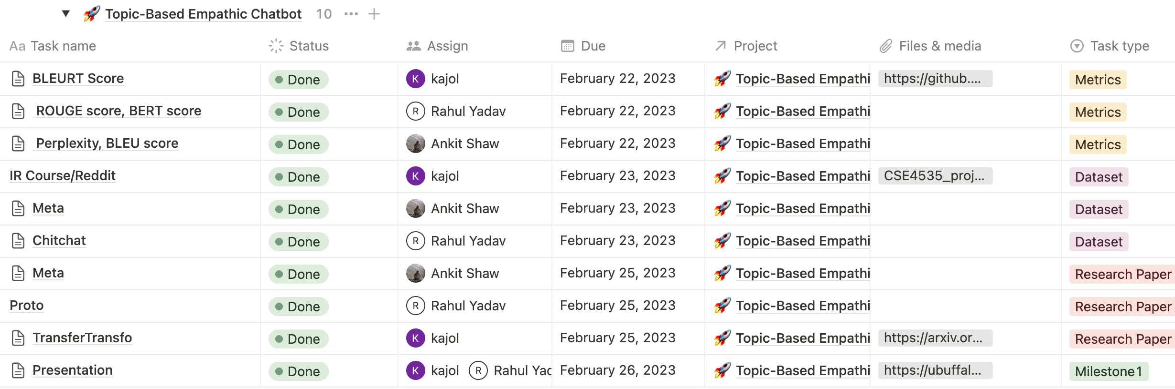
NOTION MILETSTONE 1

Slide 33
User Query
Entity Extraction
Chit Chat Model
Conversational Interface
Intent Identification
Ranking Module
Output
Entity Linking
IR Model
Knowledge Base

Slide 34
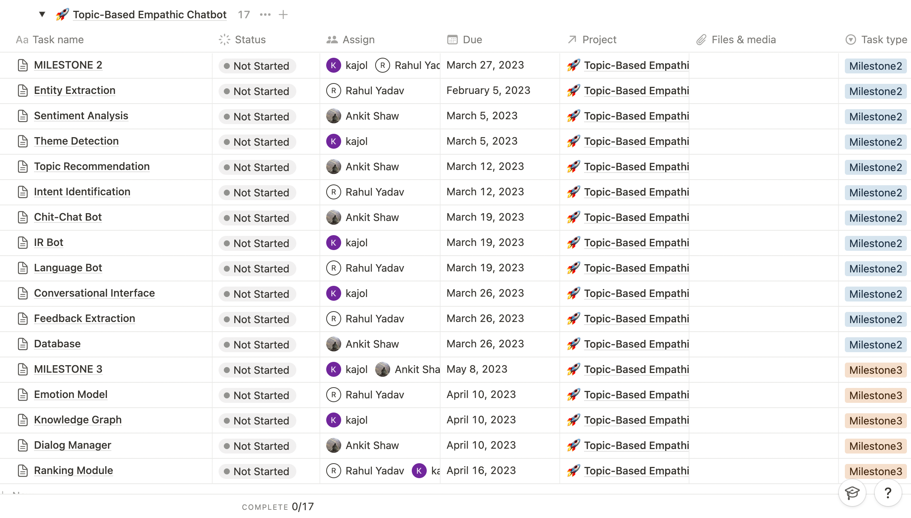
NOTION SPRINTS

Slide 37
User Query
Intent Identification
Chit Chat Model
Output
Sentiment Detection
Conversational Interface
Dialog Manager
IR Model
Re-Ranking
Generative Model
Explicit or Implicit Feedback Extraction
Knowledge Base (Elasticsearch)

